Slide 1
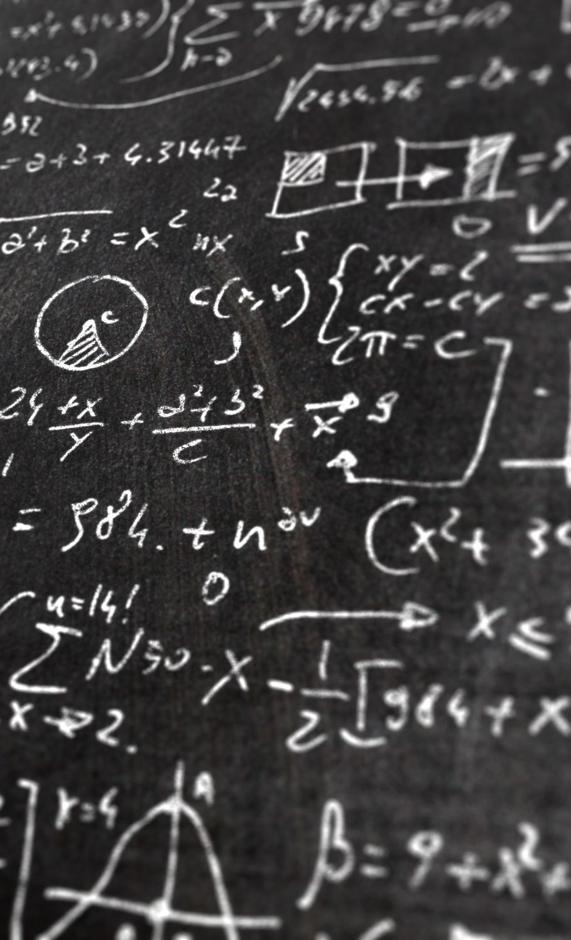
Theory of Relativity
Mechanics,PHYS101TH

Slide 2
Contents:
Introduction
Einstein’s Theory of Relativity
Special Theory of Relativity
General Theory of Relativity
Effects of Relativity

Slide 3
Introduction:
Relativity has to do with measurements of events(things that happen):where and when they happen, and by how much any two events are separated in space and in time .In addition, relativity has to do with transforming such measurements and others between reference frames that move relative to other

Slide 4
Einstein’s Theory of Relativity:
Einstein’s Theory of Relativity is actually two separate theories
a. Special Theory of Relativity
b. General Theory of Relativity

Slide 5
Special Theory of Relativity:
Special Theory of Relativity deals only with inertial reference frames, which are frames that move at constant velocities relative to one another

Slide 6
Postulates of Special Theory of Relativity:
1. The laws of physics are the same for observers in all inertial reference frames. No frame is preferred.
2. The speed of light in vacuum has the same value c in all directions and in all inertial frames.

Slide 7
General Theory of Relativity:
Einstein general theory of Relativity treats more challenging situation in which reference frames accelerate (non -Inertial frames)

Slide 8
Effects of Relativity:
Length Contraction
Mass Expansion
Time Dilation

